Slide 1
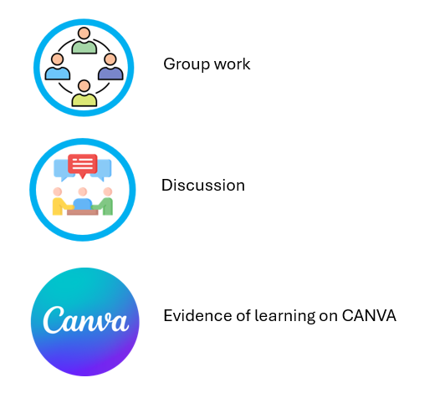
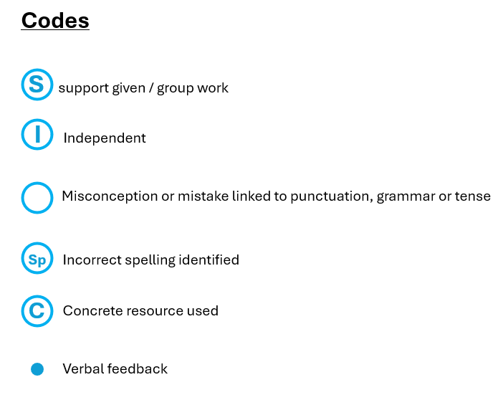
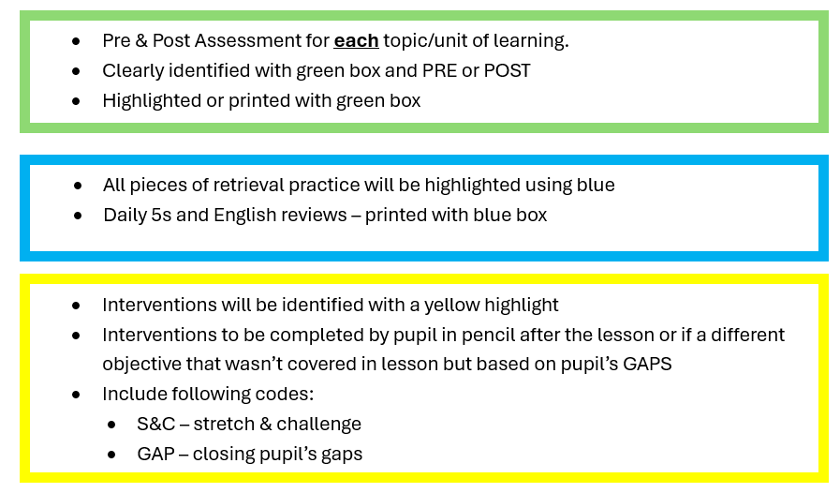

Slide 2
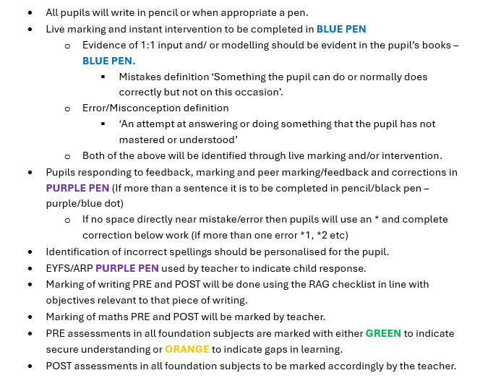

Slide 3
Codes
S support given / group work
I Independent
Misconception or mistake linked to punctuation, grammar or tense
Sp
Incorrect spelling identified
C
Concrete resource used
Verbal feedback

Slide 4



Icons
Group work
Discussion
Evidence of learning on CANVA

